Slide 1
DEPLOY TWO TIER ARCHITECTURE IN AWS
23/04/2026

Slide 2
OVERVIEW OF THE MODULE
This project is built on AWS Compute Services (AWS CCP) and teaches the basics of using cloud computing. It explains how computing works in the cloud and introduces important AWS services and ideas.Main topics are:
The basics of cloud computing and computing services
Virtual Machines and what they do in the cloud
Amazon EC2 for virtual servers that can grow
EC2 parts, types of instances, and naming rules
Starting and running EC2 instances (for both Linux and Windows)
Set up a secure web server (HTTPD) and SSH access
Amazon ECS for managing containers
AWS Elastic Beanstalk makes it easy to deploy applications
Ideas for serverless computing
AWS Lambda lets you run code without having to manage servers.
This module gives you the hands-on skills you need to deploy, manage, and scale applications in the AWS cloud environment using the Cyberarians infrastructure.
AWS Cloud Security and Infrastructure Implementation

Slide 3
PROJECT OBJECTIVES AND DURATION
Launch and configure a Linux-based EC2 instance for Cyberarians’ cloud operations.
Gain basic understanding of Virtual Machines, EC2, ECS, and serverless computing.
Approximately 90 minutes.
Start Project:
In this solution, you will walk through the step-by-step process of the tasks:
Launch a Linux-based EC2 instance using Amazon Linux 2 AMI.
Configure the instance with the necessary settings for web server operations.
Establish a secure SSH connection and perform basic network tests.
Let’s start now!
AWS Cloud Security and Infrastructure Implementation

Slide 4
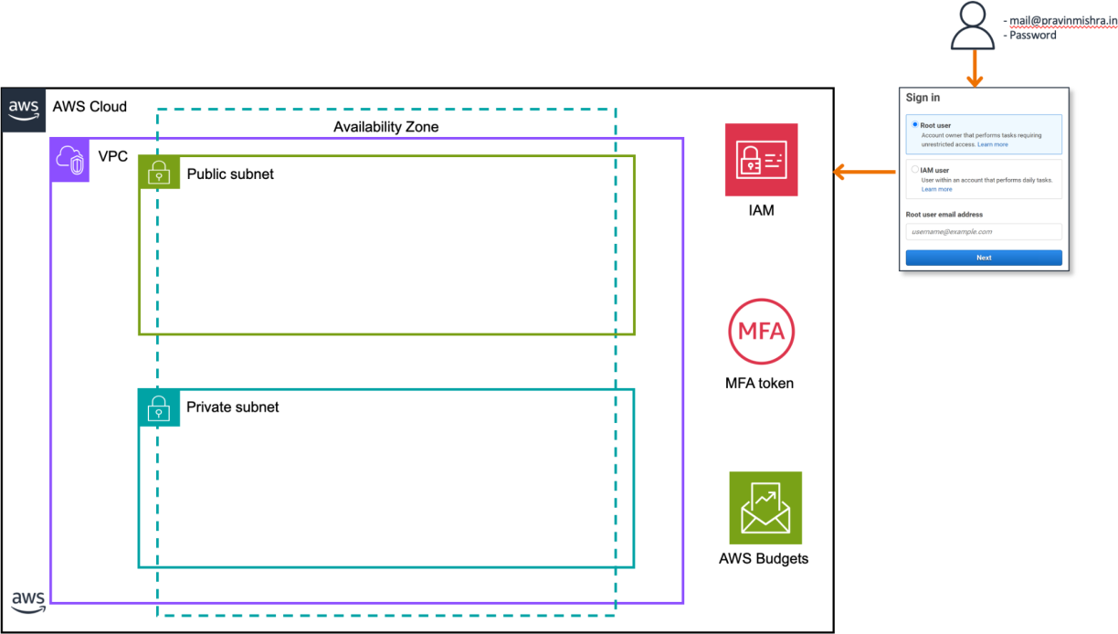

TASK 1: SETTING UP AN AWS VIRTUAL PRIVATE CLOUD (VPC) WITH PUBLIC AND PRIVATE SUBNETS FOR CYBERARIANS
AWS Cloud Security and Infrastructure Implementation
Figure 1.1.1: Virtual Private Cloud

Slide 5
PROJECT OVERVIEW:
This project involves designing and deploying a Virtual Private Cloud (VPC) within the AWS environment for Cyberarians. The setup includes both public and private subnets to create a secure, isolated network for hosting applications and services.
Project Objectives:
Build a VPC that ensures strong security and proper network isolation for AWS resources.
Configure public subnets for internet-facing resources and private subnets for restricted internal components.
Design the VPC architecture following best practices to support security, scalability, and efficient resource management.
AWS Cloud Security and Infrastructure Implementation

Slide 6
STEP 1: PLANNING AND DESIGN
1. Understand CIDR Notation:
CIDR notation defines an IP range using an address and a prefix (e.g., /16, /24). The prefix shows how many bits are used for the network—smaller values (like /16) provide more IP addresses, while larger values (like /24) provide fewer.
2. Plan Subnets and Sizes:
Identify how many subnets are needed and their sizes based on usage.
Divide them into public subnets (internet access required) and private subnets (restricted access).
Example design: Use a VPC CIDR block of 10.0.0.0/16.
  Public subnets: 10.0.0.0/24, 10.0.1.0/24
  Private subnets: 10.0.2.0/24, 10.0.3.0/24
This structure ensures proper IP distribution, scalability, and clear network segmentation.
AWS Cloud Security and Infrastructure Implementation

Slide 7
STEP 2: CREATING THE VPC:
1. Access the AWS Console:
  Log in to your AWS account and navigate to the AWS Management Console.
2. Choose the Desired Region:
  At the topmost corner of the AWS Management Console, select the region where you want to create your VPC. For instance, if you're selecting the Asia Pacific region, choose the appropriate region from the dropdown menu (Figure 1.1.3: Region Selection)
3. Go to the VPC Dashboard:
  In the AWS Management Console, locate the "Services" menu and select "VPC" under the "Networking & Content Delivery" section.
AWS Cloud Security and Infrastructure Implementation

Slide 8
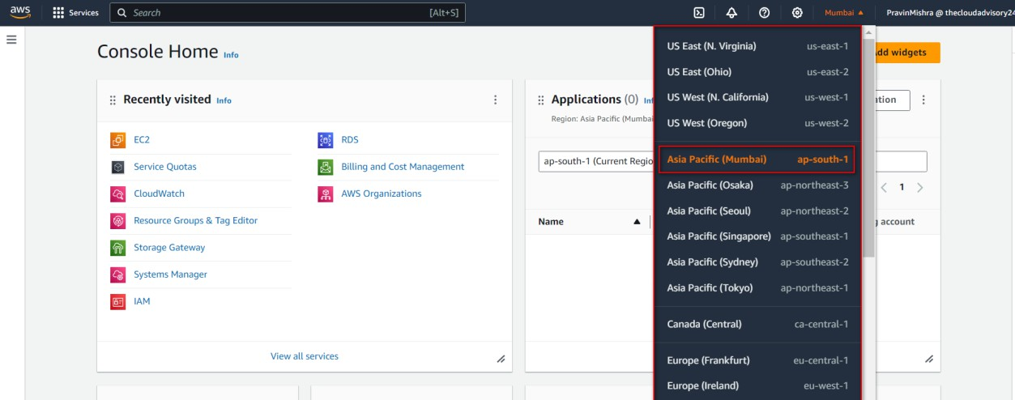
STEP 2: CREATING THE VPC:
AWS Cloud Security and Infrastructure Implementation
Figure 1.1.3: Region Selection

Slide 9
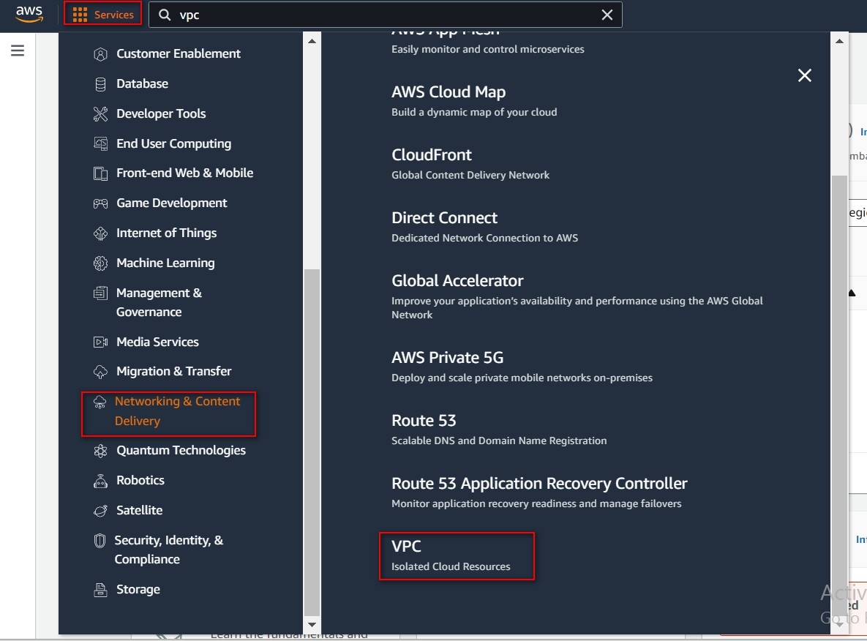
AWS Cloud Security and Infrastructure Implementation
Figure 1.1.4: Select VPC

Slide 10
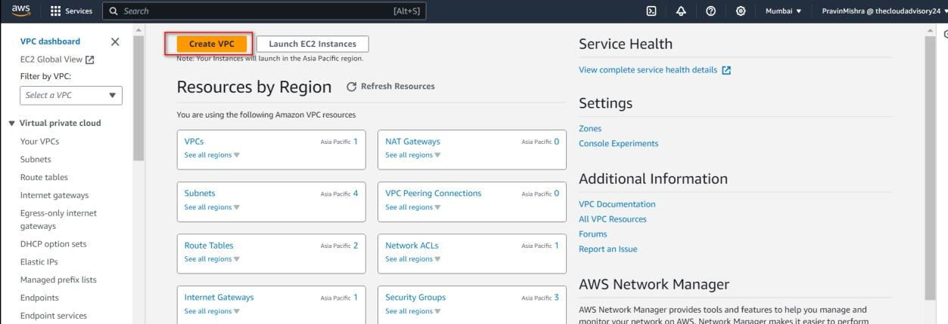
4. Create a New VPC:
  Click on "Create VPC" in the left sidebar of VPC Dashboard. (Figure 1.1.5: Create VPC)
AWS Cloud Security and Infrastructure Implementation
Figure 1.1.5: Create VPC

Slide 11
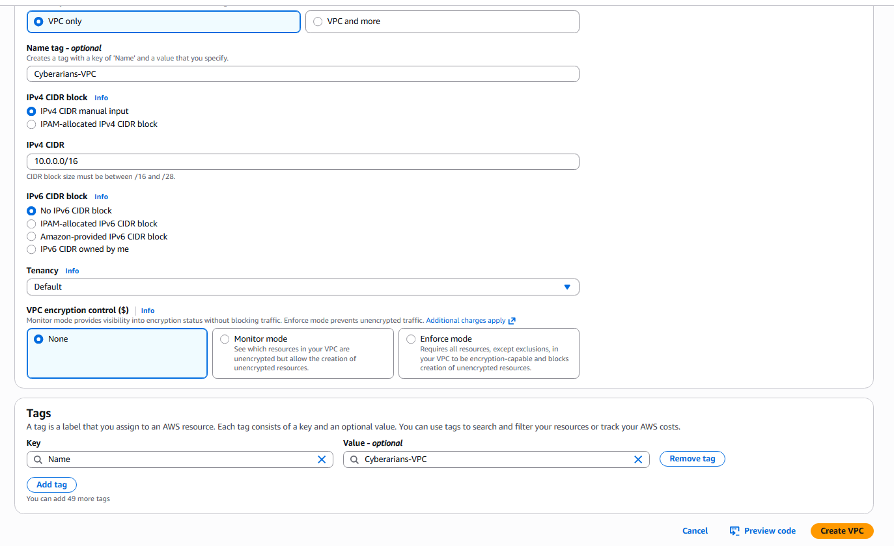
  In the resource to create option click on "VPC only" and provide the name of the VPC in the name tag.
  Enter the IPv4 CIDR block you previously selected in the earlier steps (for example, 10.0.0.0/16) in the "IPv4 CIDR block" field. This defines the range of private IP addresses for your VPC's instances. (Figure 1.1.6: VPC Settings)
AWS Cloud Security and Infrastructure Implementation

Slide 12
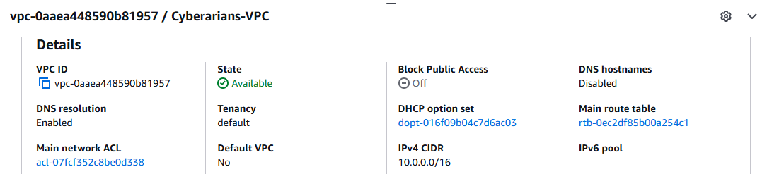
VPC now creates and views the details in the VPC Dashboard. (Figure 1.1.7: VPC Details)
AWS Cloud Security and Infrastructure Implementation

Slide 13
STEP 3: SETTING UP SUBNETS:
1. Create Public Subnets:
  In the VPC Dashboard, navigate to "Subnets" on the left sidebar and click on "Create subnet." (Figure 1.1.9: Create Subnet)
Public Subnet 1
VPC: Cyberarians-VPC
AZ: 1a
CIDR: 10.0.1.0/24
Public Subnet 2
AZ: 1b
CIDR: 10.0.2.0/24
Private Subnet 1
AZ: 1a
CIDR: 10.0.3.0/24
Private Subnet 2
AZ: 1b
CIDR: 10.0.4.0/24
AWS Cloud Security and Infrastructure Implementation

Slide 14
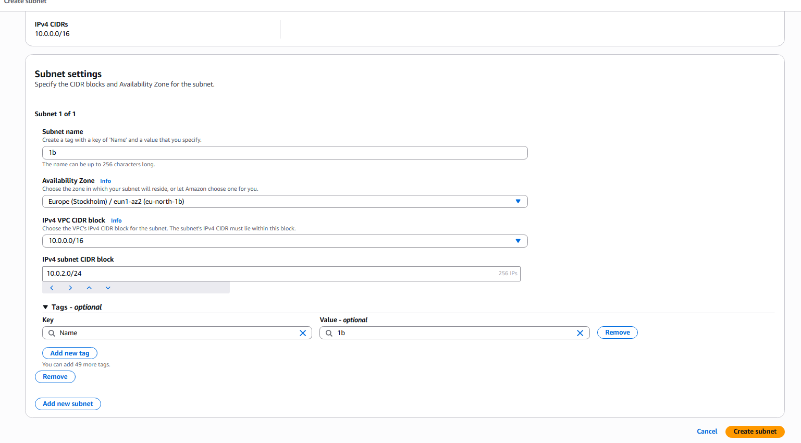
Public Subnet 1 and 2
AWS Cloud Security and Infrastructure Implementation
Figure 1.1.8: Subnet Settings

Slide 15
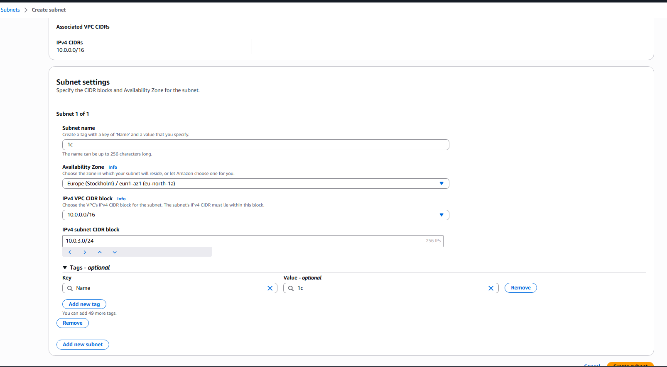
Private Subnet 1
AWS Cloud Security and Infrastructure Implementation
Figure 1.1.9: Subnet Settings

Slide 16
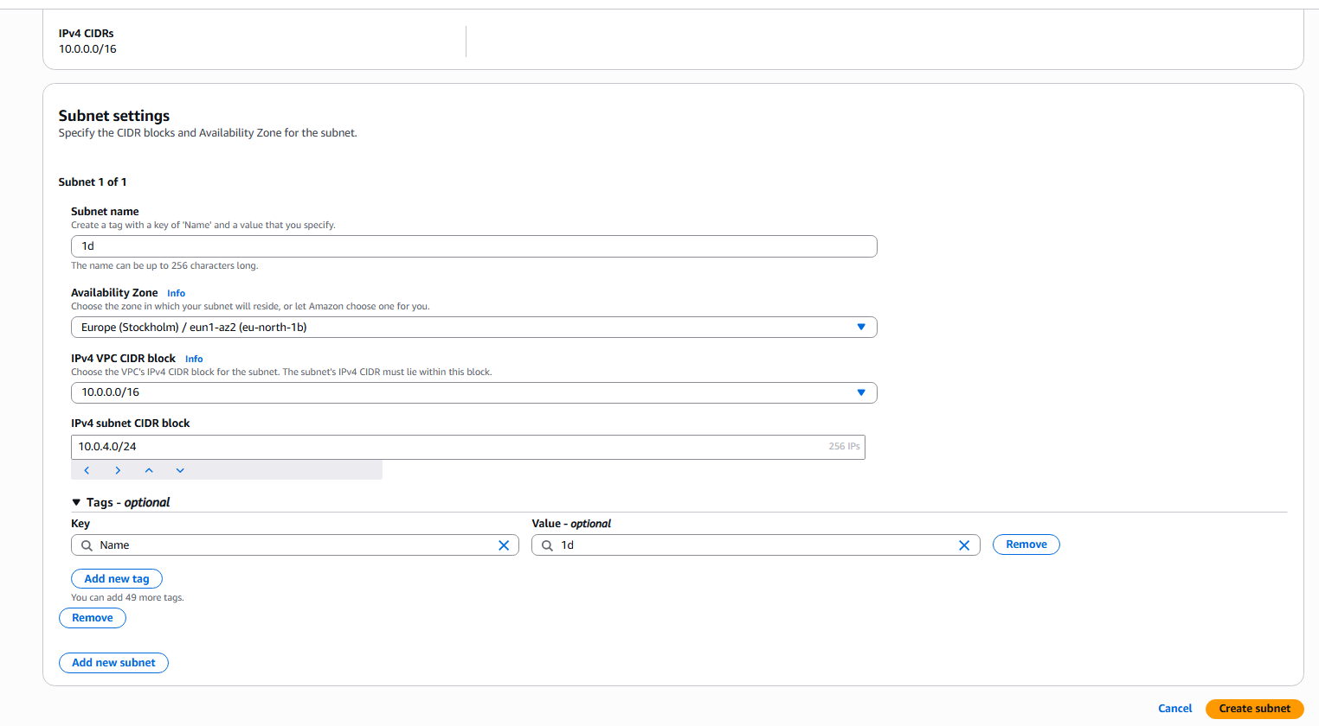
Private Subnet 2
AWS Cloud Security and Infrastructure Implementation
Figure 1.1.10: Subnet Settings

Slide 17
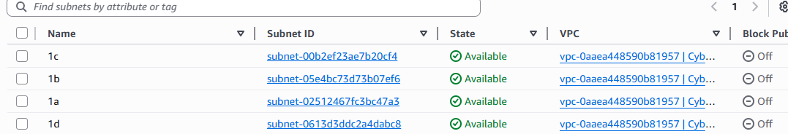
Get back to the VPC console, Select the Subnets and you will find the Subnets that you have created a while ago! (Figure 1.1.11: Subnets of Cyberarians)
AWS Cloud Security and Infrastructure Implementation

Slide 18
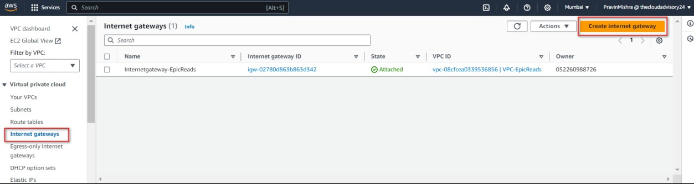
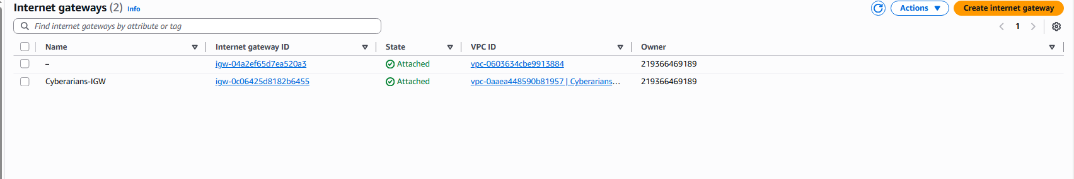
STEP 4: CONFIGURING INTERNET ACCESS:
1. Set Up Internet Gateway (IGW) for Public Subnets:
  In the VPC Dashboard, click on "Internet Gateways" in the left sidebar. (Figure 1.1.13: Create Internet Gateway)
AWS Cloud Security and Infrastructure Implementation
  Click on "Create internet gateway" and provide a name for the IGW. (Figure 1.1.15: Internet Gateway Settings)

Slide 19
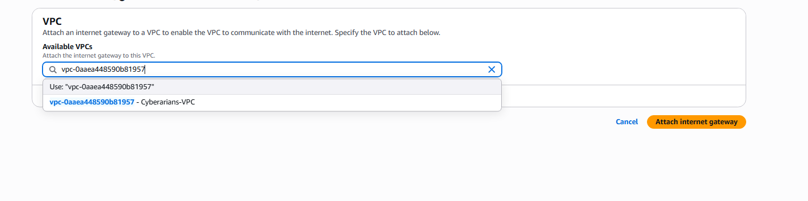
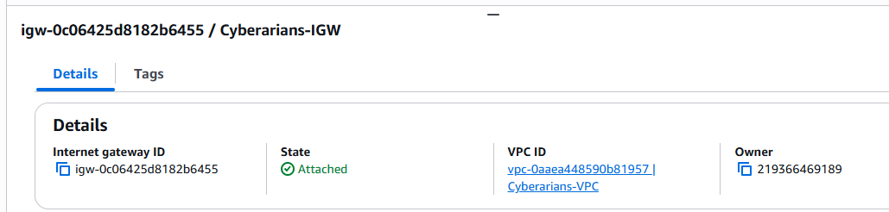
  Select the newly created IGW and click on "Attach to VPC," then choose your VPC from the list. (Figure 1.1.16: Attach to VPC)
  Once VPC is attached, you can see the details in the internet gateways Tab. (Figure 1.1.17: IGW Details)
AWS Cloud Security and Infrastructure Implementation

Slide 20
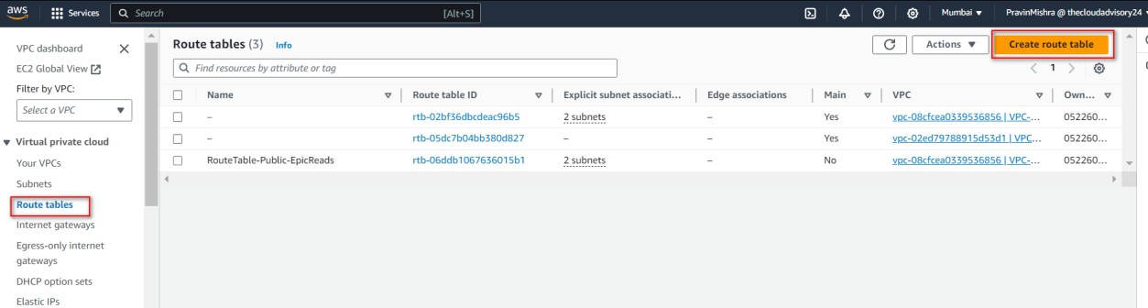
2. Update Route Tables for Public Subnets:
VPC → Route Tables → Create
Name: Public-RT
VPC: Cyberarians-VPC
Destination | Target
0.0.0.0/0 | Internet Gateway
AWS Cloud Security and Infrastructure Implementation
Figure 1.1.18: Route Tables

Slide 21
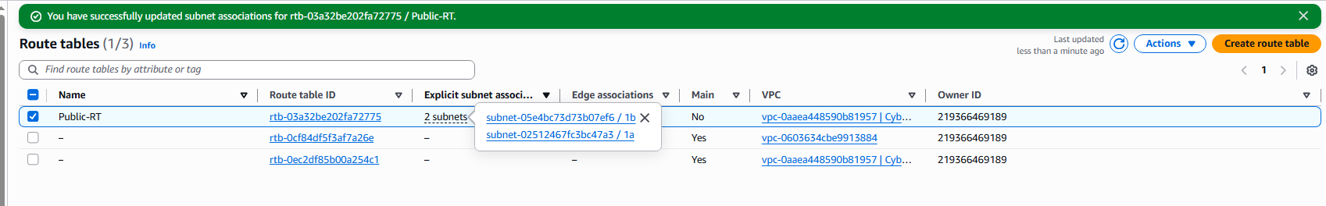
Associate: Attach:
Public Subnet 1
Public Subnet 2
AWS Cloud Security and Infrastructure Implementation
Figure 1.1.19: Route Tables

Slide 22
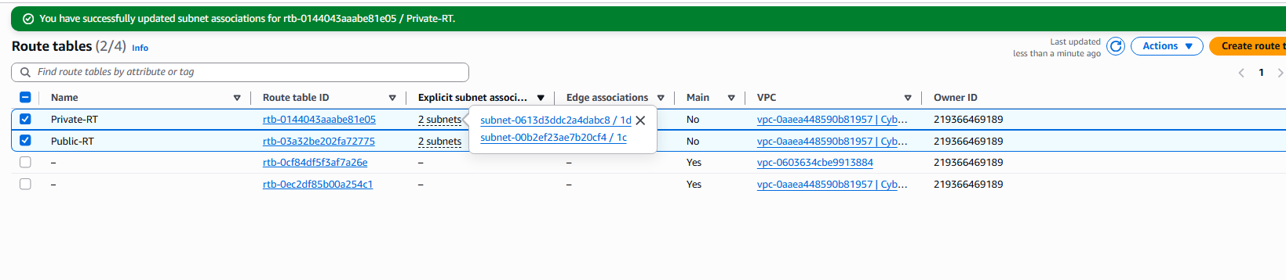
2. Private Route Table
Create another:
Name: Private-RT
Important:
DO NOT attach Internet Gateway here
Associate:
Private Subnet 1
Private Subnet 2
AWS Cloud Security and Infrastructure Implementation
Figure 1.1.20: Route Tables

Slide 23
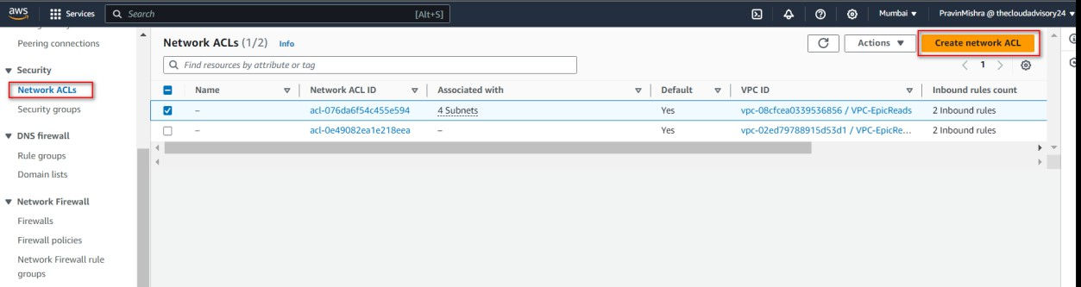
STEP 5: IMPLEMENTING NETWORK SECURITY:
1. Create Network Access Control Lists (NACLs):
● In the VPC Dashboard, click on "Network ACLs" in the left sidebar.
● Click on "Create network ACL."
AWS Cloud Security and Infrastructure Implementation
Figure 1.1.21: NACL details

Slide 24
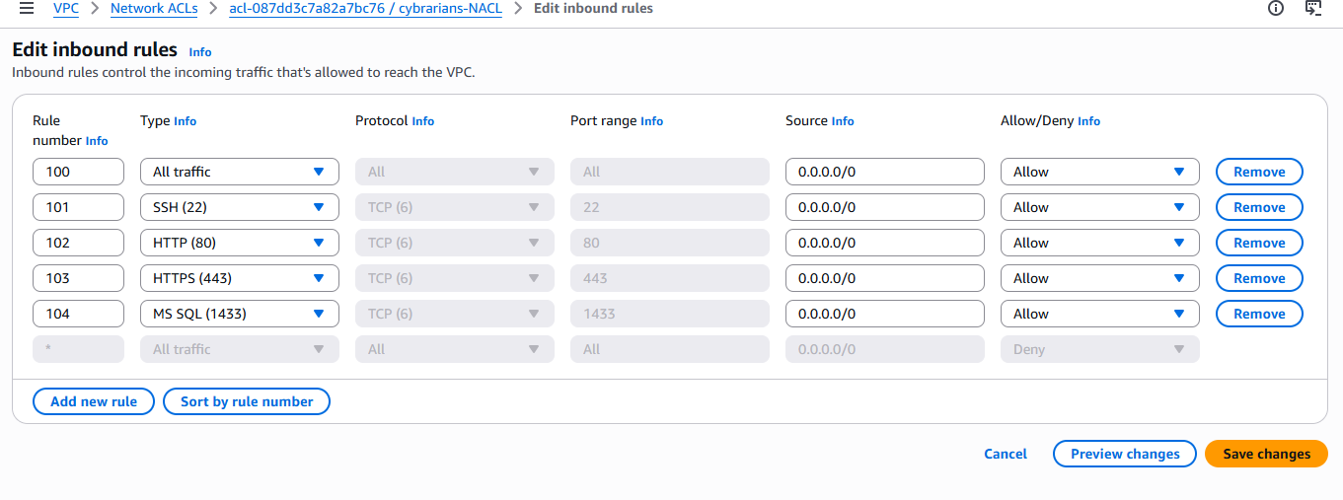
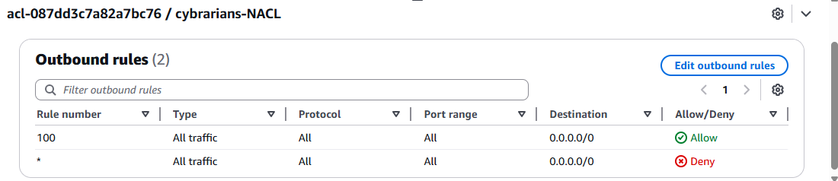
  Configure inbound and outbound rules to control traffic.
  Remember that NACLs are stateless, so you'll need to define rules for both inbound and outbound traffic.(Figure 1.1.22: Edit Inbound Rules)
Figure 1.1.22: Edit Inbound Rules
AWS Cloud Security and Infrastructure Implementation
Figure 1.1.23: Edit outbound Rules

Slide 25
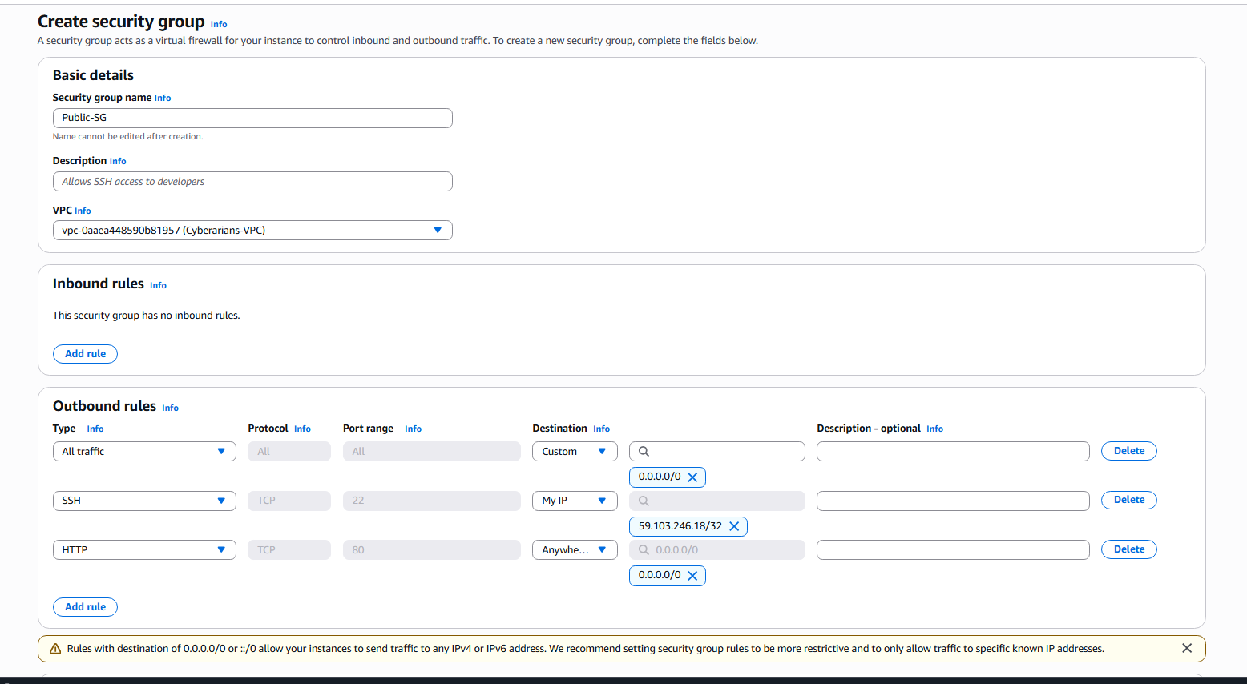
2. Create Security Groups:
  Go back to the VPC Dashboard and click on "Security Groups" in the left sidebar.
  Click on "Create security group."
Public EC2 Security Group
Name: Public-SG
Rules: SSH (22) → your IP , HTTP (80) → 0.0.0.0/0
AWS Cloud Security and Infrastructure Implementation
Figure 1.1.24: Public EC2 Groups

Slide 26
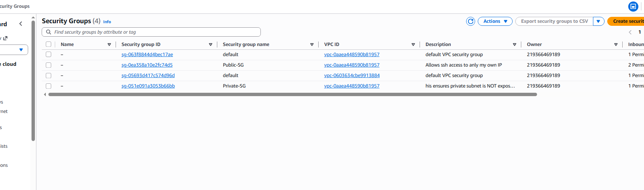
Private EC2 Security Group
Name: Private-SG
Rules:
SSH (22) → ONLY Public Subnet or Public SG
This ensures private subnet is NOT exposed.
AWS Cloud Security and Infrastructure Implementation
Figure 1.1.24: Private EC2 Groups

Slide 27
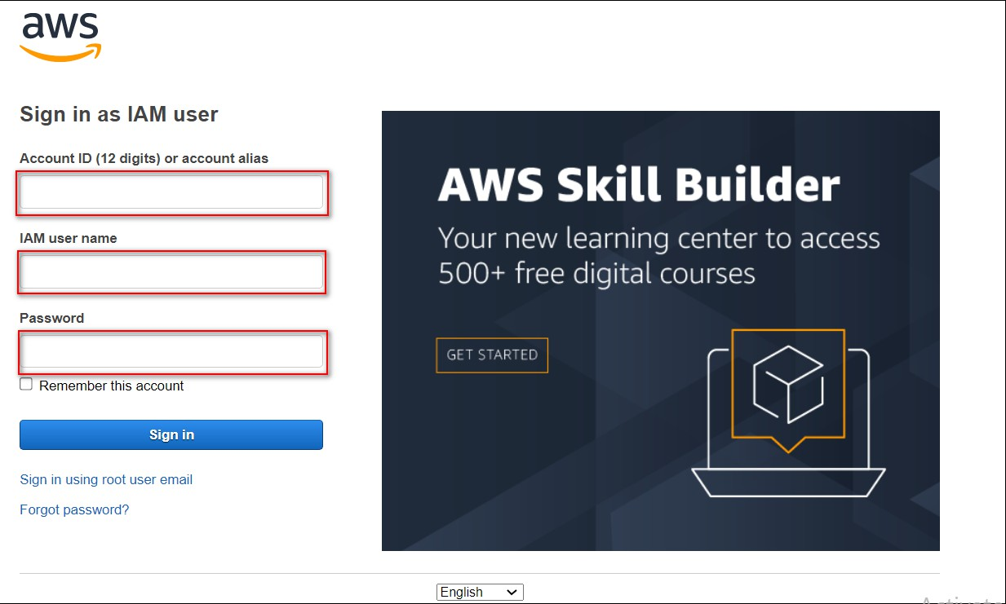
TASK 2. LAUNCHING AND CONFIGURING A LINUX EC2 INSTANCE AT CYBERARIANS
STEP 1: Launching an EC2 Instance in AWS
Sign in to AWS Console: Go to the AWS Management Console at
https://console.aws.amazon.com/ (Figure 1.1: Search result).
AWS Cloud Security and Infrastructure Implementation

Slide 28
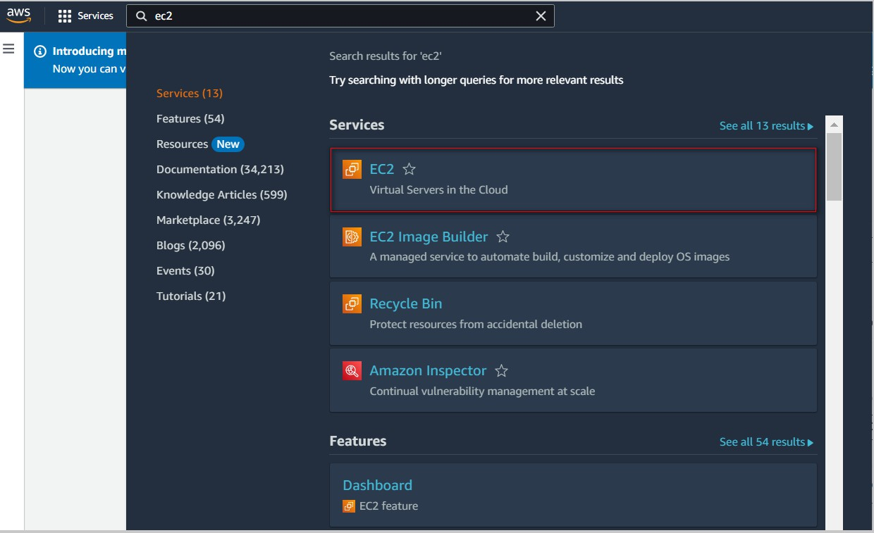
Navigate to EC2 Dashboard:
Click on the "Services" dropdown in the top left corner.
Select "EC2" under the "Compute" section. (Figure 1.2: EC2 Search result)
AWS Cloud Security and Infrastructure Implementation

Slide 29
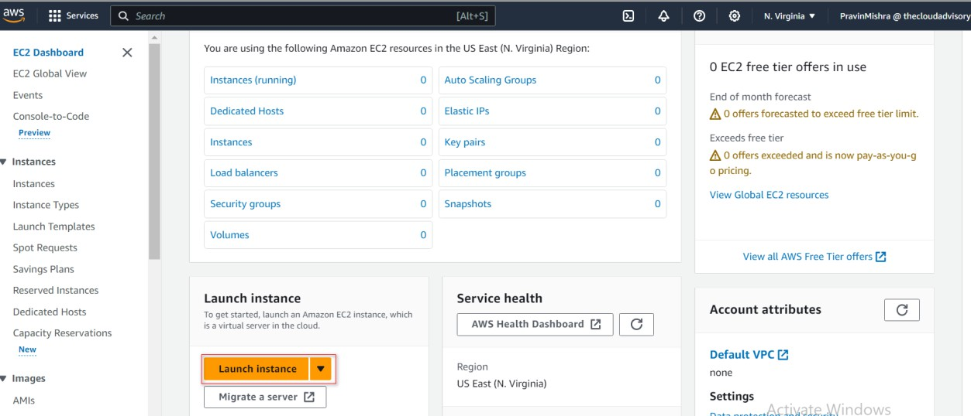
Launch Instance:
Click on the "Instances" link in the EC2 Dashboard.
Press the "Launch Instance" button.(Figure 1.3: Launch Instance Tab)
AWS Cloud Security and Infrastructure Implementation

Slide 30
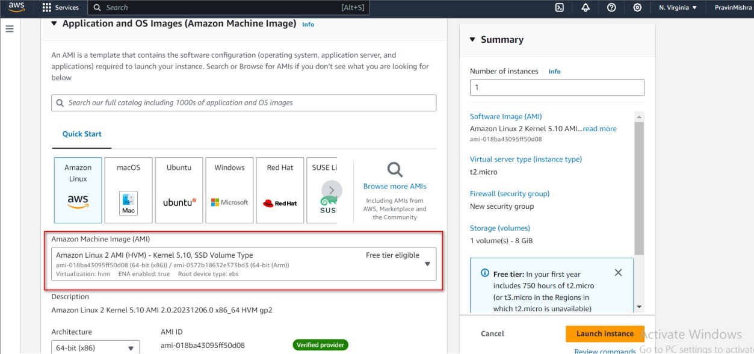
Choose an Amazon Machine Image (AMI):
Select "Amazon Linux 2 AMI" from the list of available AMIs.
Click on "Select" to proceed. Figure 1.4: Choose an Amazon Machine Image (AMI)
AWS Cloud Security and Infrastructure Implementation

Slide 31
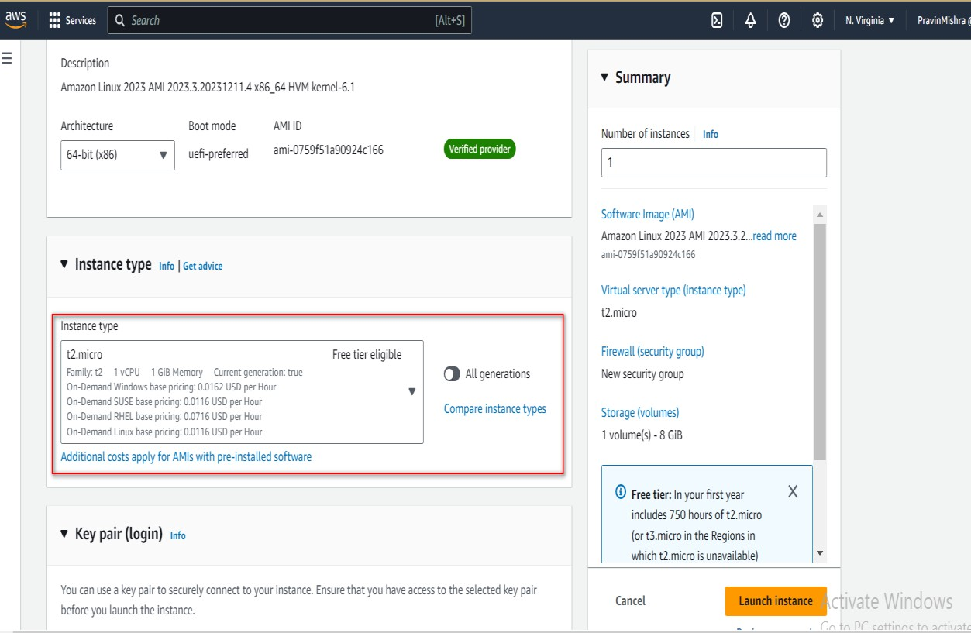
Choose t3.micro as the instance type for this exercise.
(Figure 1.5: Choose an Instance Type)
AWS Cloud Security and Infrastructure Implementation

Slide 32
STEP 2: KEY PAIR CREATION
Select “Create a new key pair” during EC2 setup.
Enter a unique name for the key pair.
Download the .pem file and store it securely.
This key pair is required for secure SSH access to the Amazon EC2 instance.
AWS Cloud Security and Infrastructure Implementation

Slide 33
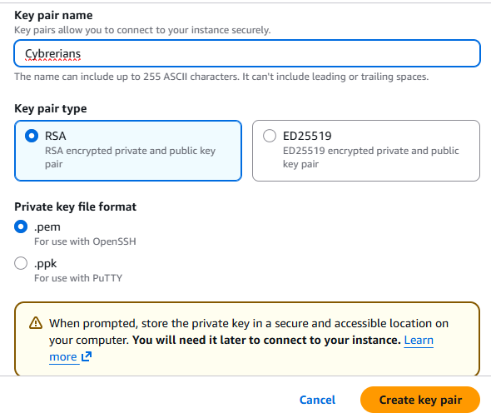
AWS Cloud Security and Infrastructure Implementation
Figure 1.6: Key Pair Creation

Slide 34
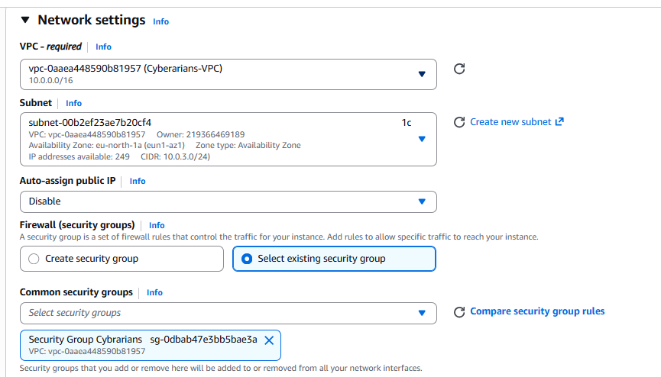
STEP 3: VPC AND NETWORK CONFIGURATION:
Use an existing VPC, ensuring it's connected to a public subnet.
Enable "Auto-assign public IP" to ensure the instance is accessible over the internet. (Figure 1.7: VPC and Network Configuration)
AWS Cloud Security and Infrastructure Implementation

Slide 35
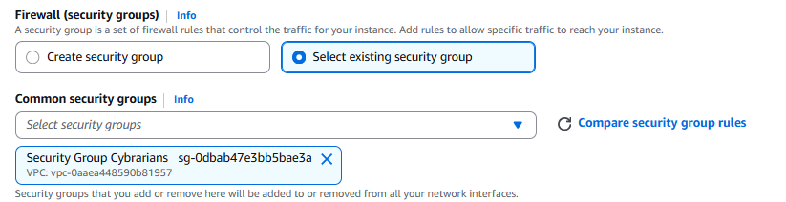
STEP 4: SECURITY GROUP SETUP:
Create a new security group for instance and specify the group name and description. (Figure 1.8: Security Group Setup)
AWS Cloud Security and Infrastructure Implementation

Slide 36
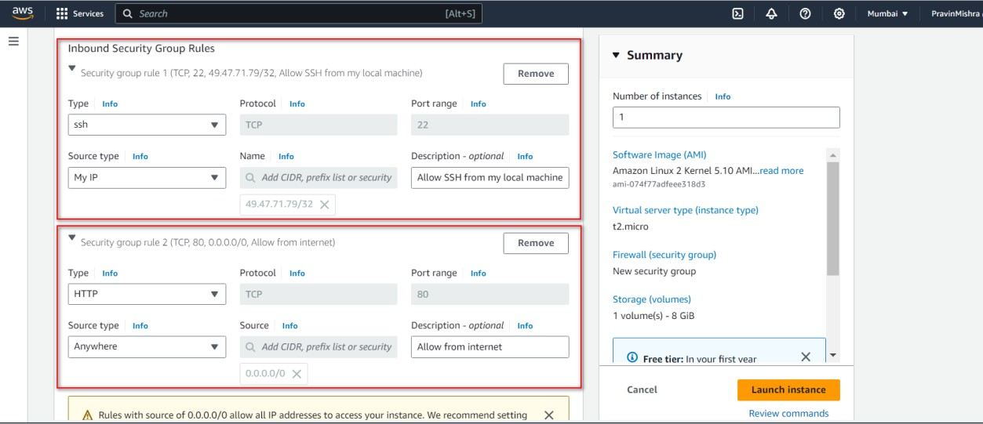
Configure inbound rules to allow traffic on ports 22 (SSH) and 80 (HTTP) from the internet. (Figure 1.9: Security Group Rules).
AWS Cloud Security and Infrastructure Implementation

Slide 37
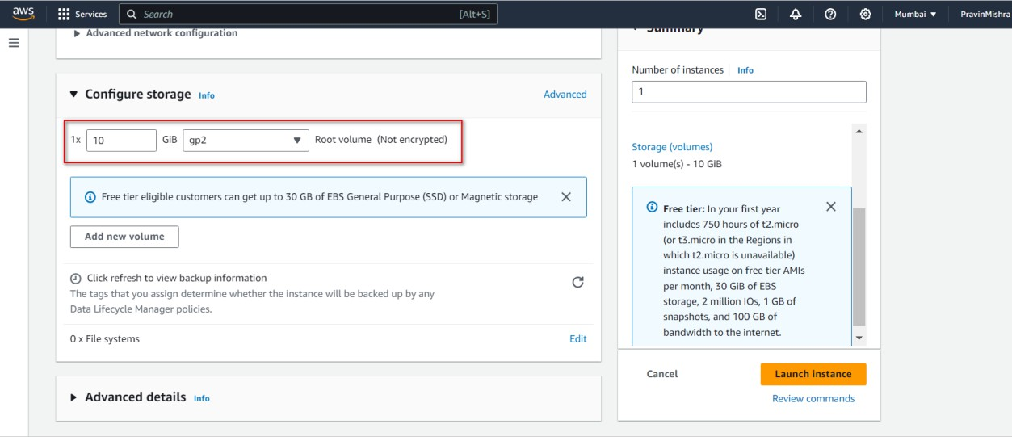
STEP 5: STORAGE CONFIGURATION:
Modify the instance’s storage settings, setting the size to 10 GB.(Figure 1.10: Storage Configuration)
AWS Cloud Security and Infrastructure Implementation

Slide 38
Click “Launch Instance” to complete the setup and start your Amazon EC2 instance.
AWS Cloud Security and Infrastructure Implementation
Figure 1.10: Launch Instance Final

Slide 39
STEP 6: CONNECTING TO EC2 VIA SSH
a. Select your Amazon EC2 instance from the dashboard.
b. Click “Connect” at the top.
c. Open the SSH client tab.
d. Copy the provided command (including username), e.g.:
ssh -i /path/to/your-key.pem ec2-user@your-instance-public-ipv4
AWS Cloud Security and Infrastructure Implementation

Slide 40
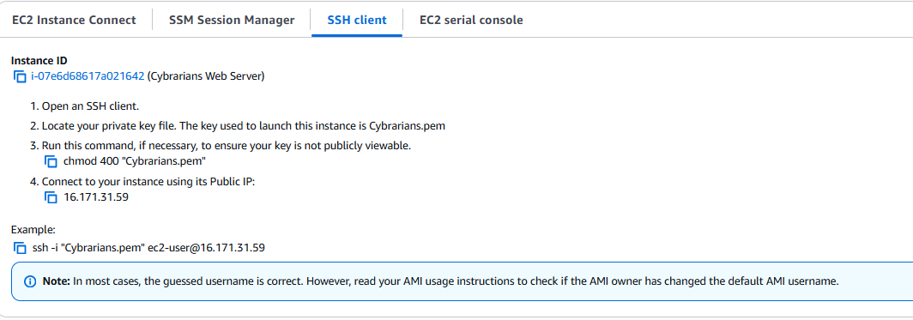
AWS Cloud Security and Infrastructure Implementation
Figure 1.11: SSH Client Console

Slide 41
STEP 7: CONNECTING VIA COMMAND LINE (TERMINAL)
a. Open a terminal (Linux/macOS) or use PuTTY / Git Bash on Windows.
b. Navigate to the folder containing your key pair:
cd /path/to/your-key-pair-directory
c. Secure the key file permissions:
chmod 400 your-key-pair.pem
This ensures only the owner can read the file.
d. Connect to your Amazon EC2 instance using SSH:
ssh -i your-key-pair.pem ec2-user@your-instance-public-ipv4
Example:
ssh -i "Keypair_Cyberarians.pem" ec2-user@13.232.87.112
e. After login, verify connectivity:
ping google.com
Note: Incorrect file path or IP address is the most common cause of connection failure.
AWS Cloud Security and Infrastructure Implementation

Slide 42
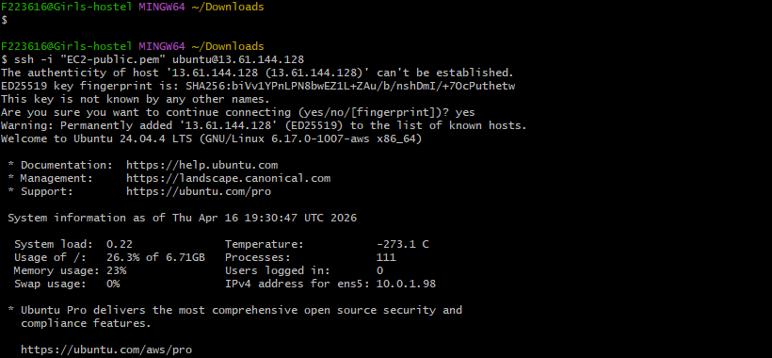
AWS Cloud Security and Infrastructure Implementation
Figure 1.12: Connecting via Command Line

Slide 43
TASK 3 : LAUNCHING, CONFIGURING, AND INSTALLING WORDPRESS ON A LINUX EC2 INSTANCE AT CYBERARIANS
Task Overview
After launching and connecting to your Linux Amazon EC2 instance, the next step is to install and configure WordPress. This simulates a real-world setup for Cyberarians to manage blogs, content, or an online book platform.
This task includes:
Installing and configuring WordPress on an Amazon Linux 2 EC2 instance.
Verifying that the website is publicly accessible and functioning correctly over the internet.
AWS Cloud Security and Infrastructure Implementation

Slide 44
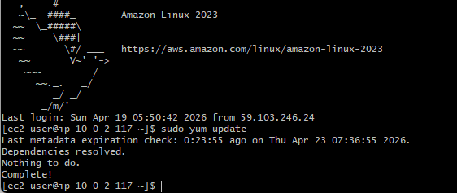
STEP 1: UPDATE AND UPGRADE PACKAGES
Once connected to your EC2 instance, update the package lists and upgrade installed packages by using sudo yum update: (Figure 2.1: Update and Upgrade Packages).
Command:
sudo yum update
AWS Cloud Security and Infrastructure Implementation
Figure 2.1: Update and Upgrade Packages

Slide 45
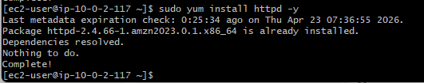
STEP 2: INSTALL APACHE WEB SERVER
Install the Apache web server by using the below command (Figure 2.2: Install Apache Web Server).
Command:
sudo yum install httpd -y
AWS Cloud Security and Infrastructure Implementation
Figure 2.2: Install Apache Web Server

Slide 46

Start the Apache service and enable it to start on boot (Figure 2.3: Apache service status)
Command:
sudo systemctl start httpd
sudo systemctl status httpd
AWS Cloud Security and Infrastructure Implementation
Figure 2.3: Apache service status

Slide 47
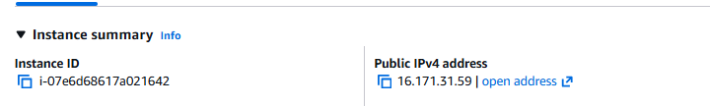
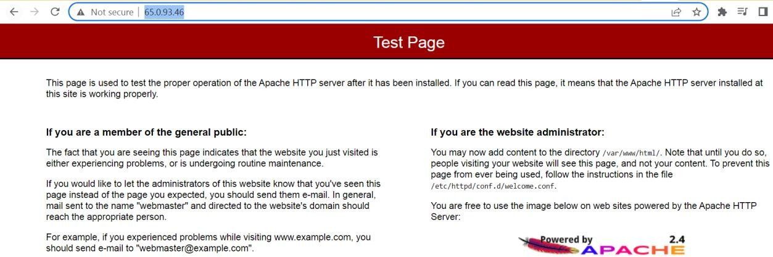
To verify the deployment of Apache HTTPD through the browser:
Obtain the public IP address of your EC2 instance (Figure 2.4: Public IP address).
Open your web browser.
Enter the EC2 instance's public IP address into the browser's address bar.
Press "Enter" to load the page (Figure 2.5: Apache Test Page).
Example: http://[EC2_Public_IP]
AWS Cloud Security and Infrastructure Implementation
Figure 2.4: Public IP address
Figure 2.5: Apache Test Page

Slide 48
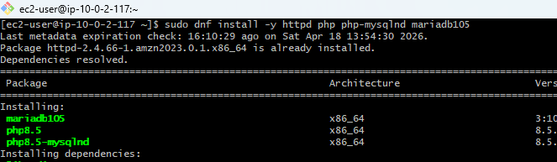
STEP 3: INSTALL PHP AND MYSQL
Install PHP along with necessary PHP extensions required by WordPress(Figure 2.6: install PHP).
Command:
sudo amazon-linux-extras install -y lamp-mariadb10.2-php7.2 php7.2
AWS Cloud Security and Infrastructure Implementation
Figure 2.6: install PHP
Command:
sudo yum install -y mysql
Figure 2.7: install MySQL

Slide 49
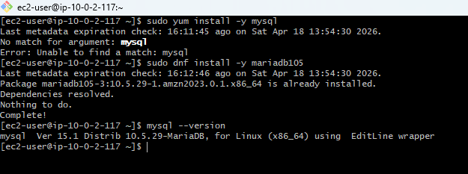
Command:
sudo yum install -y mysql
AWS Cloud Security and Infrastructure Implementation
Figure 2.7: install MySQL

Slide 50
STEP 4: WORDPRESS SETUP
Download and install WordPress on the EC2 instance(Figure 2.8: Download WordPress)
Navigate to the Web Directory:Move to the directory where you want to install WordPress. For instance, in
cd /var/www/html/
Download WordPress:Fetch the latest version of WordPress.
Command:
sudo wget https://wordpress.org/latest.tar.gz
Extract WordPress Archive:Unzip the downloaded WordPress file.
Command:
sudo tar -xzvf latest.tar.gz
AWS Cloud Security and Infrastructure Implementation

Slide 51
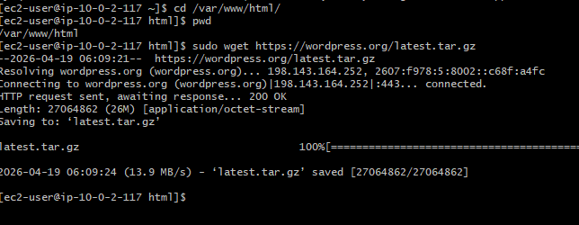
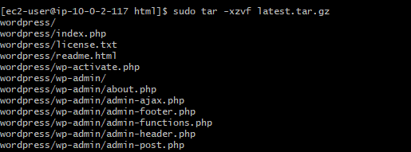
AWS Cloud Security and Infrastructure Implementation

Slide 52
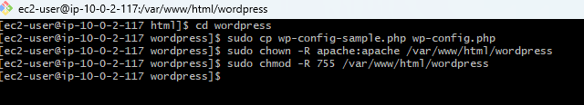
Command:
cd wordpress
Create the configuration file by copying the sample configuration.
sudo cp wp-config-sample.php wp-config.php
Set Permissions: Adjust the permissions for WordPress files.
sudo chown -R apache:apache /var/www/html/wordpress sudo chmod -R 755 /var/www/html/wordpress
AWS Cloud Security and Infrastructure Implementation
Figure 2.9: Permission for Wordpress file

Slide 53
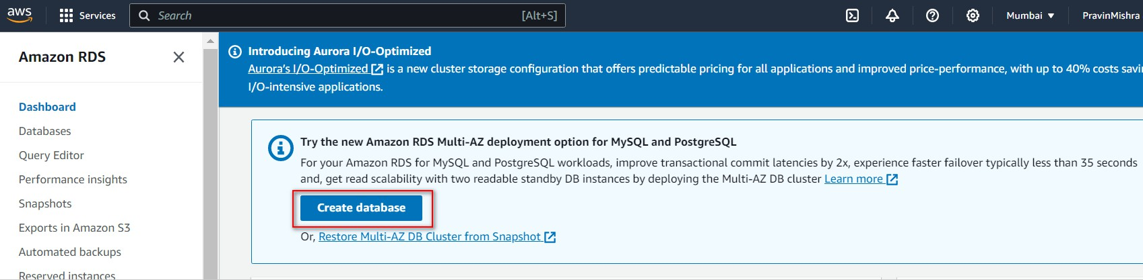
STEP 5: CREATE WORDPRESS DATABASE
Before even creating the Database, creating a subnet group is important
Navigate to the left navigation pane of the RDS dashboard and click on the Subnet groups (Figure 2.10: Create Subnet groups)
Figure 2.10: Create Subnet groups
Navigate to the RDS console and click on "Create Database."(Figure 2.10:Create Database Tab)
AWS Cloud Security and Infrastructure Implementation

Slide 54
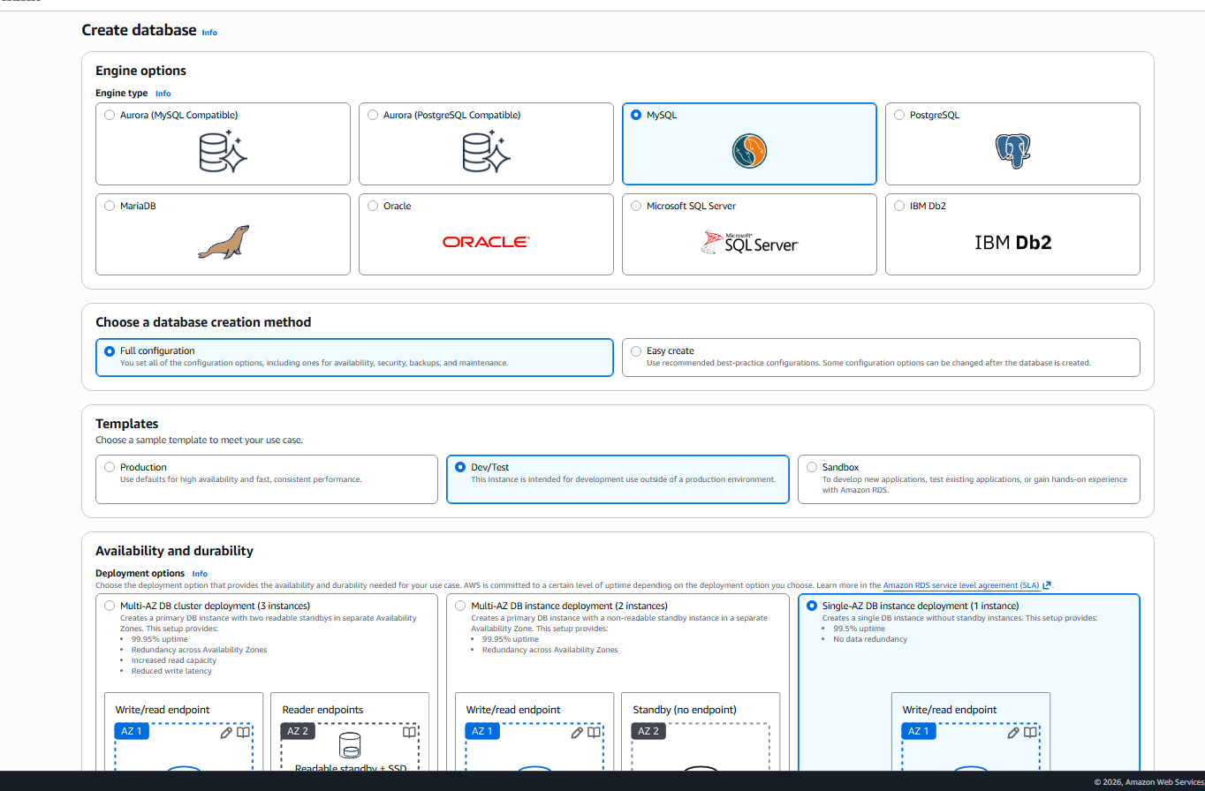
Under Engine options, choose "MySQL." (Figure 2.11:Create Database Option)
AWS Cloud Security and Infrastructure Implementation

Slide 55
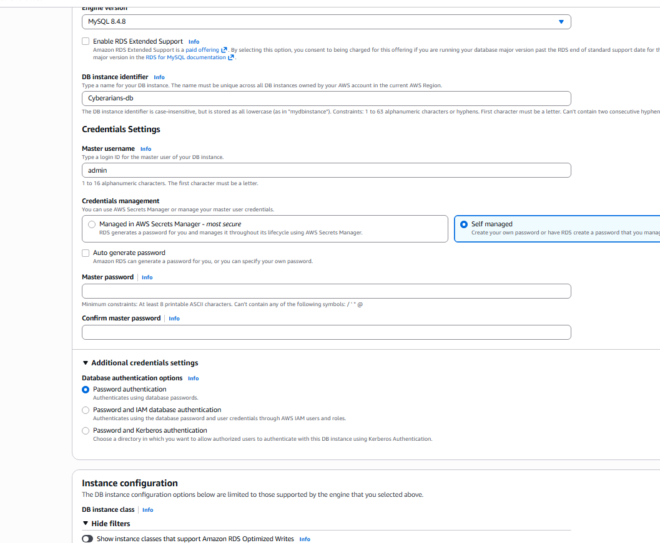
In the Settings section(Figure 2.13:Credentials Settings):
Enter “admin" as the DB identifier.
Set your desired Master username.
Define a secure Master password (e.g. Happynewyear#24) for access and also enter the same password on the confirm password tab.
AWS Cloud Security and Infrastructure Implementation

Slide 56
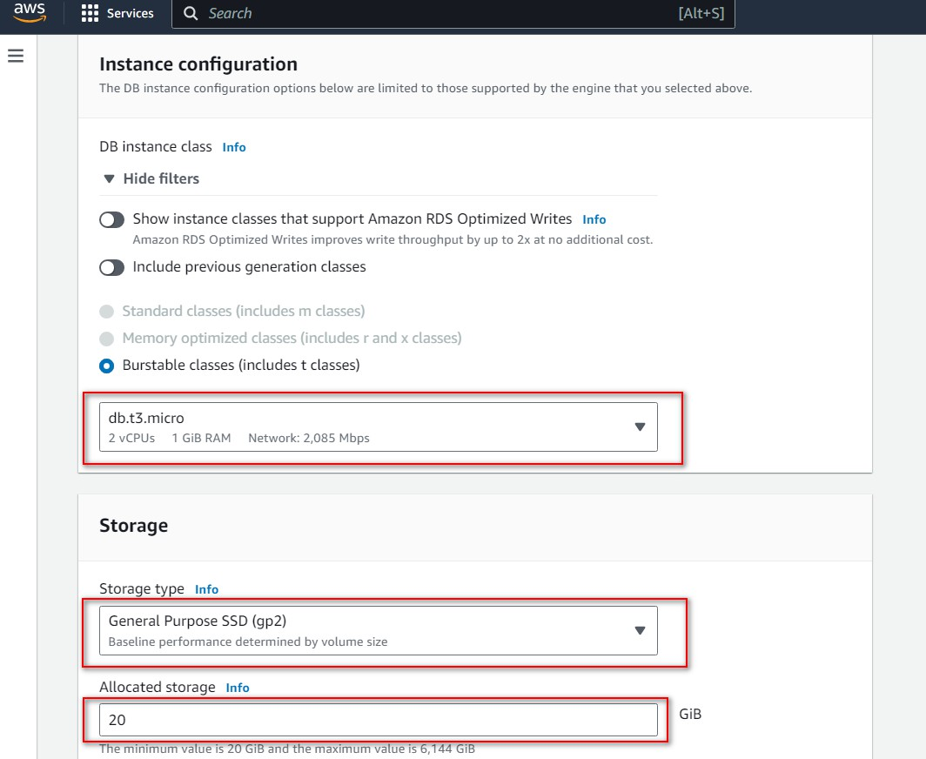
The instance configuration and storage should remain the same at their default selections(Figure 2.14:Instance Configuration).
Use the default configuration for Burstable Classes with the db.t3.micro instance type.
Specify the storage type as General Purpose SSD (gp2).
Allocate 20 GB of storage capacity.
AWS Cloud Security and Infrastructure Implementation

Slide 57
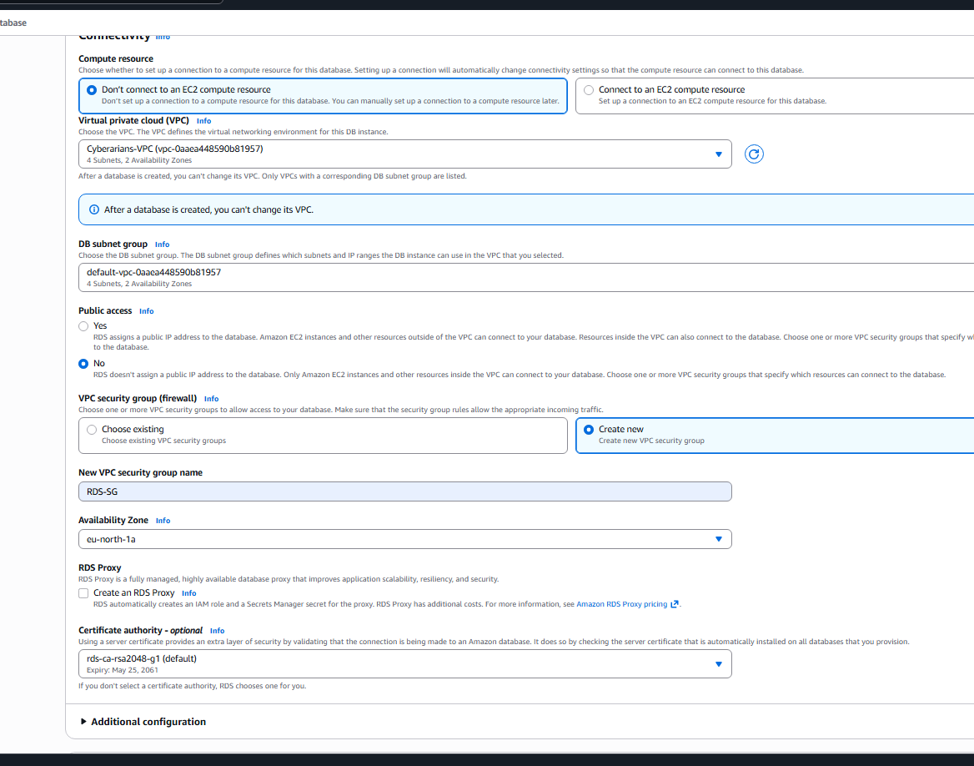
In the Connectivity section(Figure 2.15:Compute resource Configuration):
Choose the VPC named "VPC-Cyberarians" created in the preceding step.
For "Public access," select "No" to limit public access to the instance.
AWS Cloud Security and Infrastructure Implementation

Slide 58
Under "VPC security group," choose "Create new" and input "db-sg" as the name for the new VPC security group (Figure 2.16: VPC Security Group).
AWS Cloud Security and Infrastructure Implementation

Slide 59
STEP 6: SECURITY GROUPS SETTINGS
Configuring Security Group Rules
Go to Security Groups and select “public-instance-sg.”
a. Click “Edit inbound rules.”
b. Add MySQL/Aurora rule:
Click “Add rule”
Type: MySQL/Aurora
Source: Custom → select “db-sg”
Save
c. Add HTTP rule:
Click “Add rule”
Type: HTTP
Source: My IP
Save
These rules allow database communication and web access for your Amazon EC2 setup.
AWS Cloud Security and Infrastructure Implementation

Slide 60
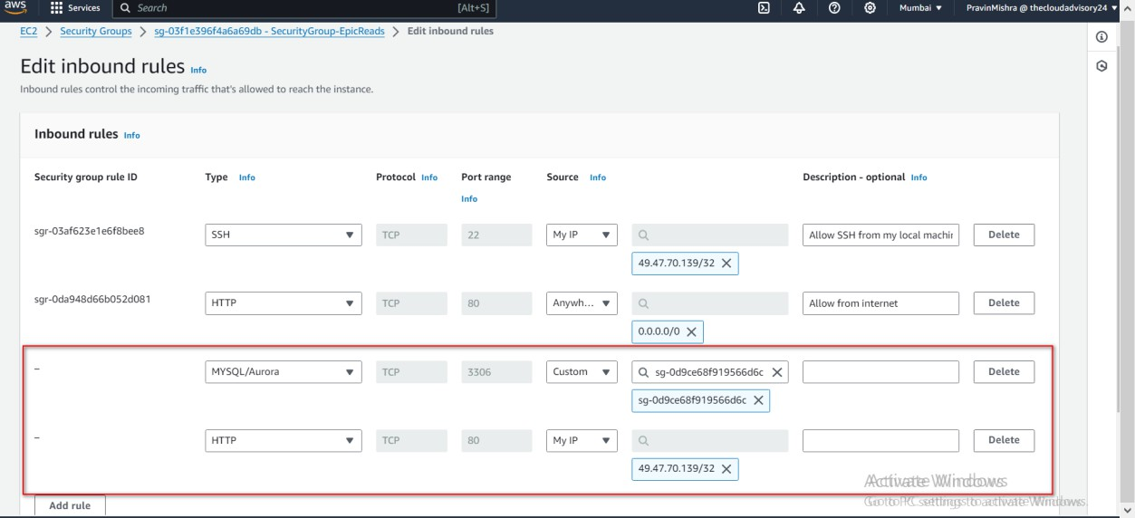
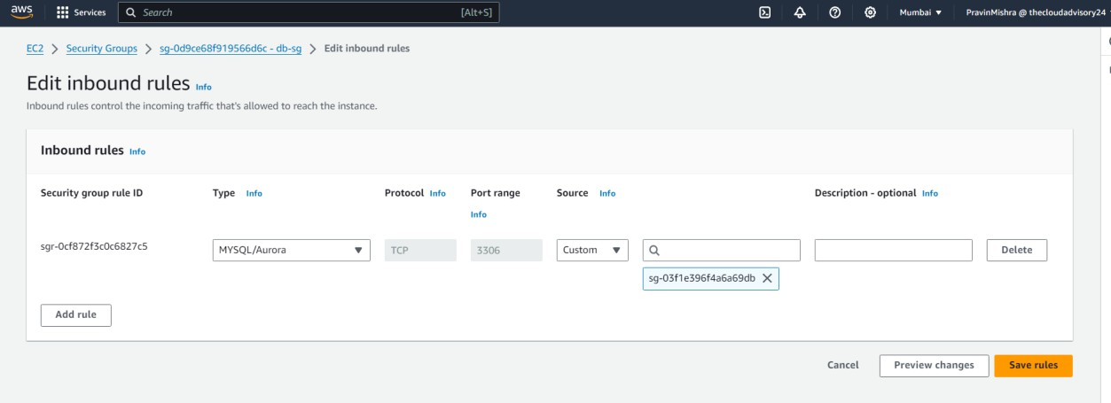
Figure 2.20: Security Group Cyberarians
AWS Cloud Security and Infrastructure Implementation
Figure 2.21: Security Group DB

Slide 61
STEP 7: CONFIGURE THE WORDPRESS INSTALLATION AND CONNECT IT TO A DATABASE
Set MySQL environment variable:
export MYSQL_HOST=<your-endpoint>
This sets your Amazon RDS endpoint for database connectivity.
Connect to WordPress database:
mysql --user=<your-username> --password=<your-password> wordpress
This logs into the database using MySQL credentials.
Create user and grant permissions:
CREATE USER 'wordpress'@'localhost' IDENTIFIED BY 'wordpress-pass';
GRANT ALL PRIVILEGES ON wordpress.* TO wordpress;
FLUSH PRIVILEGES;
This creates a WordPress database user and assigns required privileges.
Exit MySQL:
EXIT;
These steps link Amazon RDS with your WordPress installation for proper backend functionality.
AWS Cloud Security and Infrastructure Implementation

Slide 62

AWS Cloud Security and Infrastructure Implementation
Figure 2.22: DB Connection page

Slide 63
STEP 7: CONFIGURE THE WORDPRESS INSTALLATION AND CONNECT IT TO A DATABASE
Locate and Modify the Database Settings(Figure 2.24: Nano text editor page):
Inside the wp-config.php file, find the section with MySQL settings. Replace the following placeholders:
  database_name_here with the actual name of your WordPress database ('wordpress' in your case).
  username_here with the MySQL database username ('wordpress' in your case).
  password_here with the MySQL database password ('wordpress-pass' in your case).
AWS Cloud Security and Infrastructure Implementation

Slide 64

AWS Cloud Security and Infrastructure Implementation
Figure 2.24: Nano text editor page

Slide 65
Run commands to deploy Wordpress on your computer
sudo yum install php-xml -y cd ..sudo cp -r wordpress/* /var/www/html
sudo chown -R apache:apache /var/www/html Finally, start hosting the Apache web server sudo systemctl start httpd.service
sudo systemctl enable httpd.service sudo systemctl restart php-fpm
Install WordPress through the Browser:
Open a web browser and enter your EC2 instance's public IP address/wp-admin or domain name(Figure 2.27: Wordpress language page).
http://{ec2-instace-public-IP-address}/wp-admin/
AWS Cloud Security and Infrastructure Implementation

Slide 66

a. Follow the WordPress setup wizard:
Select the language and provide database connection details (database name, username, password, and host).
AWS Cloud Security and Infrastructure Implementation
Figure 2.27: Wordpress language page

Slide 67

b. Complete the WordPress setup by providing site details (site title, admin username, password, email, etc.)(Figure 2.28: Wordpress site details).
AWS Cloud Security and Infrastructure Implementation
Figure 2.28: Wordpress site details

Slide 68

AWS Cloud Security and Infrastructure Implementation
Figure 2.28: Wordpress site details

Slide 69

Login to the WordPress admin dashboard(Figure 2.30:
WordPress admin dashboard)
AWS Cloud Security and Infrastructure Implementation
Figure 2.31: WordPress admin dashboard

Slide 70

"Great job! You're almost there! This is the final step where you'll access the WordPress app's main page. You've successfully launched, set up, and installed WordPress on your Linux EC2 Instance at Cyberarians. Let's take the last exciting step together!" (Figure 2.32: WordPress Welcome Page)
AWS Cloud Security and Infrastructure Implementation
Figure 2.32: WordPress Welcome Page

Slide 71

Ensure that the WordPress installation is functioning correctly by creating a test post or page(Figure 2.33: Add New Post Page). Steps to Create a Test Post/Page:
Navigate to Posts or Pages: In the WordPress Dashboard sidebar, click on "Add New Post" to create a test post.
AWS Cloud Security and Infrastructure Implementation
Figure 2.32: WordPress Welcome Page

Slide 72


Fill in Test Post/Page Details: Enter a title for the test post or page in the designated field(Figure 2.34: Post creation Page).
AWS Cloud Security and Infrastructure Implementation

Slide 73

AWS Cloud Security and Infrastructure Implementation
Figure 2.35: Post Sample Page

